Slide 1
OpenAi Codex
Team 11: Barbara Call | Corine El Bitar | Madeleine Hayes
Notes:
Hi everyone this is team 11 blah blah blah

Slide 2
Agenda
What is OpenAi Codex
Coding Demo
Business Question
Relevant Research Paper
Ethical Concerns
Conclusion
Notes:
Read through agenda
We want to preface this presentation by saying that Codex was just recently deprecated in March. However, its underlying capabilities have been integrated into OpenAi’s GPT 3.5/4 and it leveraged by other platforms so its not gone for good and it will probably sound a lot like Chat GPT.

Slide 3
OpenAi Codex
Natural language → code
Trained on public GitHub repositories
Capabilities
Convert comments to code
Autofill code snippets
Translate code between programming languages
Debugging
Code explainability function
Terminal commands assistant
etc.
Works with other developers
Notes:
OpenAi Codex is a language to code AI model that can turn simple English instructions into code in 12 different coding languages like Python, PHP, Javascript, C++, Swift, Java and Ruby...
It was released in August of 2021 through OpenAi’s API and was trained on billions of lines of code from public github repositories. Some of Codex’s capabilities include turning comments into code and auto completing code snippets which are both done inside the code editor, translating code between programming languages, and debugging which is a huge capability of Codex as this is one of the most time consuming parts of developing software. Using Codex, You’re able to highlight a snippet of code and it’ll explain its functionality and there is a terminal commands assistant. Codex works closely with other developers to build on top of codex and leverage these capabilities.

Slide 4

Coding Demo:
GitHub Copilot
Codex is the principal building block of GitHub Copilot
# Write the Tanh function from scratch using only the Numpy library
# Use a for loop to call the Tanh function you wrote above using input values ranging from -10 to 10 (including both -10 and 10) with increments of 5
# For each function call, print the output as "The Tanh value of x is y" in a new line
Replace x and y with appropriate values
Notes:
One example of this collaboration is GitHub Copilot which uses Codex to suggest code and functions from comments right in the editor. Codex is the principal building block of GitHub Copilot and is what we’ll be doing a coding demo on. So to use copilot you’re able to add it as an extension in VS Code and access Codex’s capabilities directly in the editor. * open SV Code and do example *

Slide 5
Business Question
What are the implications for software developers given the software development capabilities of OpenAi Codex?
Notes:
With these profound capabilities in mind, the business question we are aiming to address is; What are the implications for software developers given the software development capabilities of OpenAi Codex? Will it cause these individuals to lose jobs or will it just enhance their skill set and what they are capable of?

Slide 6
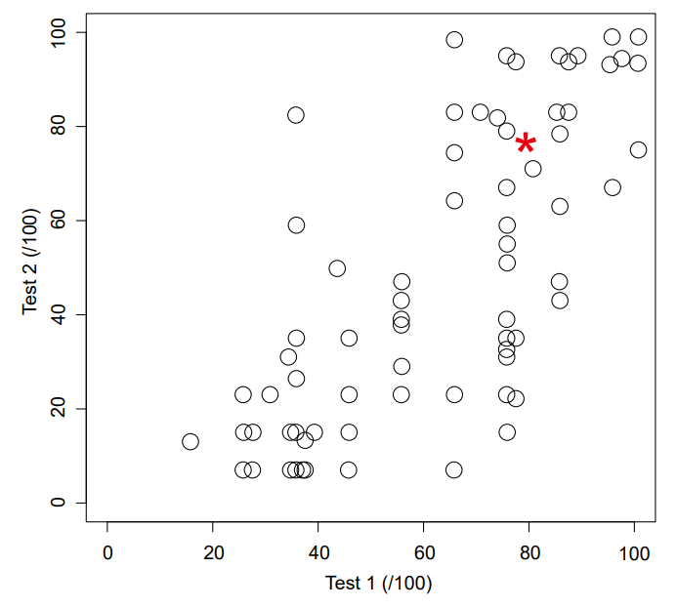
Research Paper:
Exploring the Implications of OpenAI Codex on Introductory Programming
How does Codex perform on first year assessments compared with CS1 students?
Results : codex scored 78.5% for test 1 and 78% for test 2
Falls within the top quartile
How does Codex perform on variations of a benchmark computing education problem that differ in context and level of detail?
Rainfall problem
Codex didn't perform well when input values are not valid
Notes:
The research article we looked at is called Exploring the Implications of OpenAi Codex on Introductory Programming and it looked at how codex performs on an intro level computer science exam. They evaluated codex’s performance on real questions taken from introductory programming exams and compared the results to students who took these same exams under normal conditions. The first test they gave to Codex was an assessment of 23 programming questions that were used in a CS1 programming course. They generated a maximum of 10 responses per question and if none of them passed the autograder test then it was marked unsolved. The results were Codex scored a 78.5% for Test 1 and 78.0% for Test 2 which both fall in the top quartile. It struggled the most with questions that asked for multiple constraints. For example with the question that asked “use a while loop to perform the task” but don’t “use the split() method”, codex produced 9 solutions that used a while loop but only one answer attempted it without split. For the second test they gave Codex 6 variations of the Rainfall Problem. The rainfall problem is a well known programming problem that involves processing and analyzing rainfall data. The specific details of the problem can vary depending on the context and the requirements of the program,with the core challenge being to efficiently process and analyze a large amount of data. Since these questions involved higher level specifications and multiple parameters, Codex did not perform as well on these problems. Codex struggles on cases where no valid values are provided as input which was the case for a lot of these questions. The results show that Codex performs better than most students on coding questions in first year programming exams, and performs okay in most variations of the Rainfall Problem. While Codex can be very helpful, it isn't always perfect and the answer it gives should be reviewed by human eyes before its implemented in a program.

Slide 7
Ethical Concerns
Bias
Security
Intellectual Property
Transparency
Job displacement
Notes:
Thx maddie. So the First ethical concern encountered is Bias, If you recall, in AI, team 11 talked a little bit about bias with facial recognition and model cards. Like any machine learning model, Codex is only as unbiased as the data it was trained on. If the data is biased, the model will learn and perpetuate those biases. Codex was trained on Python code from 54 million public GitHub repositories. Github has been around since 2008, and it is unclear how old or secure the code in these repositories was. Additionally, Codex is not a developer, and becoming overly dependant on it, for example, blindly approving any code it generates without revision, will lead to small subtle mistakes. Previously when going through the demo for this presentation, Github Copilot forgot to import numpy. Overlooking these mistakes will result in lower quality code and security risks.There is also the question of who owns the code generated by the model. At least a portion of the code with which Codex was trained, such as code snippets from textbooks, is under a restrictive license, and its use could be considered intellectual-property infringement. This could put businesses and developers at risk if they were to unintentionally incorporate copyrighted data into their production software. Next, there is the issue of transparency, where exactly is the information generated coming from? Model cards or even a hyperlink referencing repositories used could help clear up some of that uncertainty while also addressing the intellectual property issue. Lastly is job displacement which leads us back to our business question. what is the impact of Codex on software development jobs?

Slide 8
Conclusion
Revolutionary
Lowers barriers to entry
Not enough though - still must have coding background to know when codex isn’t giving the right answers
Should be looked at as an asset, not a threat
Notes:
Based on our research, we believe that OpenAi’s Codex model is revolutionizing how individuals write and develop code and has drastically lowered barriers of entry to software development. While it has incredible features, it is not human. It doesn't understand context, and sometimes makes mistakes that take human eyes to understand. Code-generating systems are currently not a replacement for human developers and instead should be looked at as an asset to developers rather than a threat of job displacement. It allows developers to debug, build, test, and deploy models faster than ever before so they are able to focus on software design and functionality. Not just anyone can use the tool, you still need to have a technical and conceptual idea of what you want to build and, when partially incorrect responses are generated, you need to have enough coding background to understand and interpret the response to fix it. You need the experience everyone in this room has acquired. Thank you

Slide 9
References
Code-generating AI can introduce security vulnerabilities, study finds | TechCrunch
https://dl.acm.org/doi/pdf/10.1145/3511861.3511863
https://openai.com/blog/openai-codex
https://platform.openai.com/docs/guides/code

